Slide 1
IMDB Movie Analysis

Slide 2
Approach
Project Description
The dataset provided is related to IMDB Movies. A potential problem to investigate could be: "What factors influence the success of a movie on IMDB?" Here, success can be defined by high IMDB ratings. The impact of this problem is significant for movie producers, directors, and investors who want to understand what makes a movie successful to make informed decisions in their future projects.
The approach towards this project is to analyze the data thoroughly and to understand business problem.
Tech-Stack Used
This project is done in MS EXCEL to explore, analyze and visualize data. And the report is submitted in Power Point Presentation

Slide 3
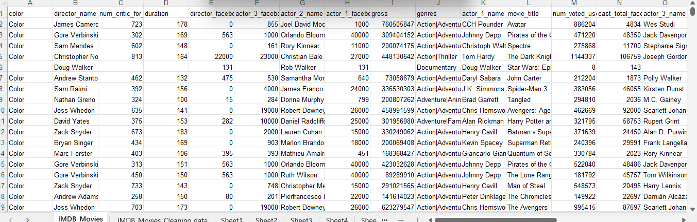
Data Cleaning
This step involves preprocessing the data to make it suitable for analysis. It includes handling missing values, removing duplicates, converting data types if necessary, and possibly feature engineering.
RAW DATA, which contains 28 columns and 5044 rows

Slide 4
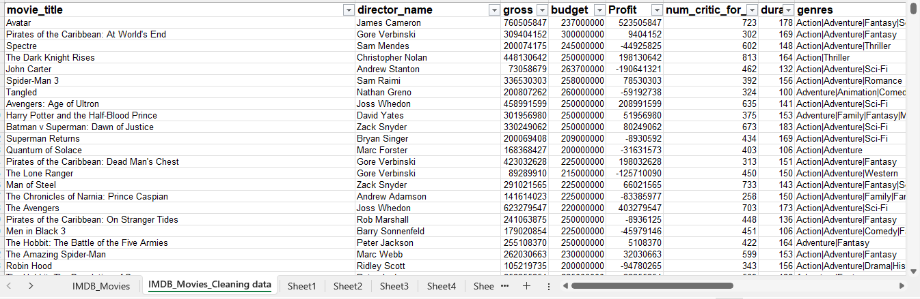
DATA after cleaning, which contains 16 columns and 4870 rows
Drop some unnecessary columns, and deleted some rows due to missing values. Created new “Profit” column. Missing values for “Gross”, “Budget” and “Profit” are ignored as average of these are used.

Slide 5
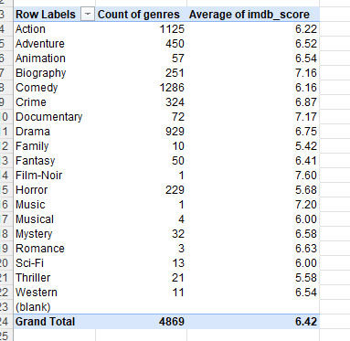
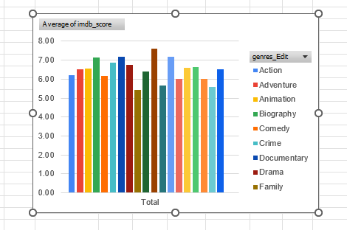
A. Movie Genre Analysis
Analyze the distribution of movie genres and their impact on the IMDB score.

Slide 6
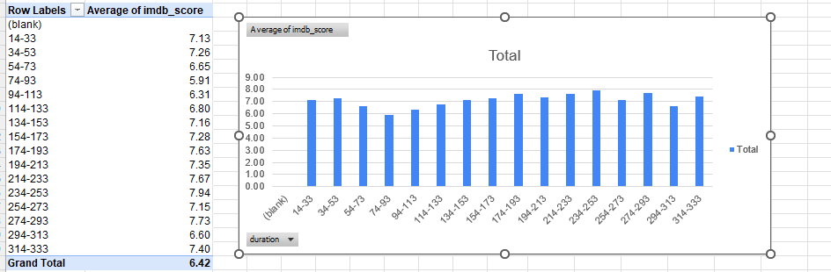
B. Movie Duration Analysis
Analyze the distribution of movie durations and its impact on the IMDB score.

Slide 7
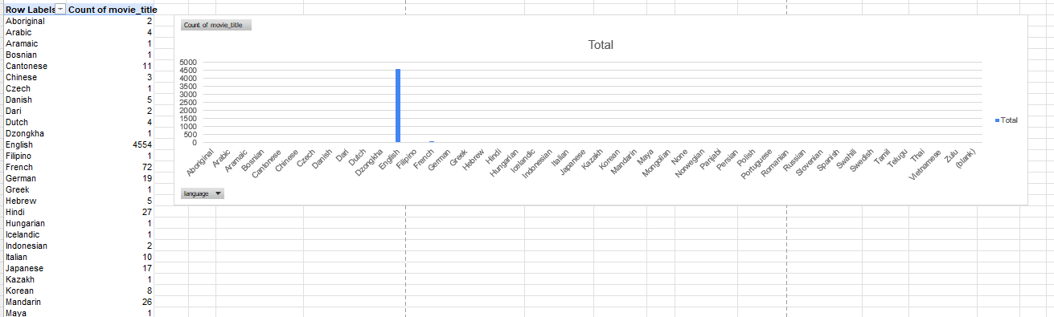
C. Language Analysis
Examine the distribution of movies based on their language.

Slide 8
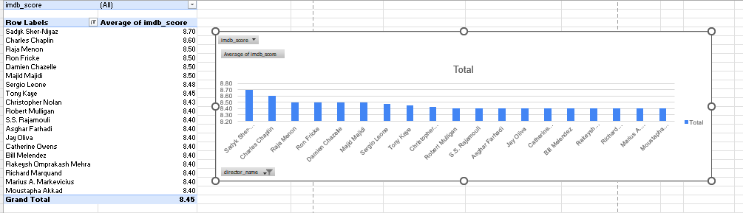
D. Director Analysis
Influence of directors on movie ratings.

Slide 9
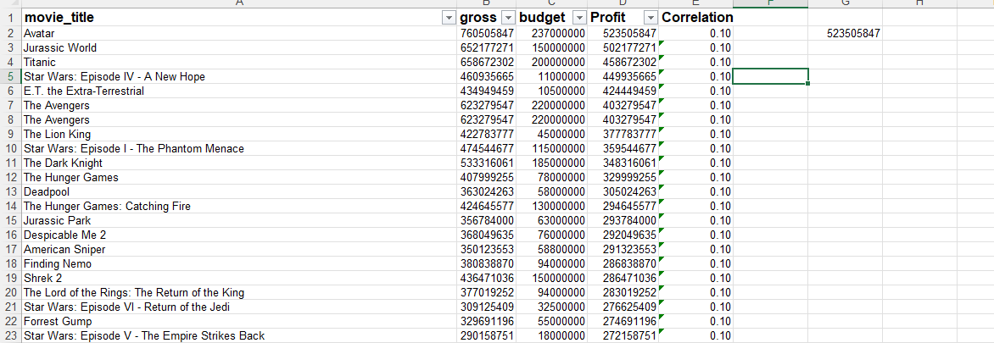
E. Budget Analysis
Explore the relationship between movie budgets and their financial success.

Slide 10
Insights
From these project I get to know the following:
Biography, Documentary, Film-Noir and Music have more than 7.0 IMDB score.
Duration of movies are not at all impacted on IMDB scores
Most of the movies are in English language
Director Sadyk Sher-Niyak have the highest average IMDB score
Avatar movie got the highest profit of all

Slide 11
THANK YOU

